Slide 1

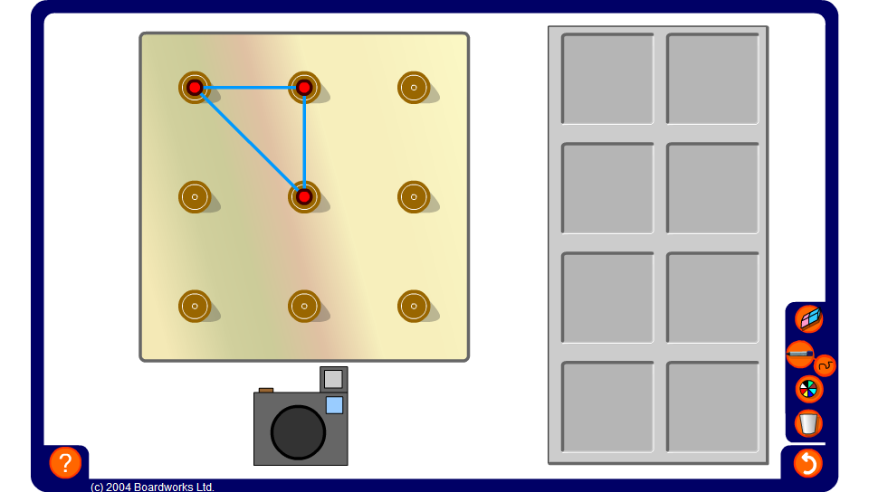


Triangles on a 3 by 3 pegboard
Notes:
Challenge pupils to find the eight distinct triangles (not including reflections, rotations and translations) that can be made on a 3-by-3 pegboard.
Classify them according to their side, angle and symmetry properties.
There should be 2 scalene, 3 right-angled isosceles, 1 right-angled and 2 isosceles triangles.

